Slide 1

Google Tunix Hackathon Project
Explainable AI Research
Google-Tunix
Checklist Reasoning
with GRPO
Training Language Models to Show Their Work
Lead Developer
Research Support
Kanishk Surwade
Sarthak

Slide 2
Problem Statement
01
When LLMs Skip the Steps
The Core Problem
Three Critical Challenges
Large Language Models excel at producing correct answers, but most models do not explicitly explain their reasoning steps . This creates a critical gap between output and understanding.
1
Skipped Reasoning Steps
Models jump directly to answers without showing intermediate logic
✗
✗
✗
Transparency
Trust
Reliability
2
Inconsistent Reasoning
Logic varies unpredictably across similar prompts
Our Objective
To fine-tune an open-weight LLM so that it explicitly produces a reasoning trace before generating a final answer, making the model's thought process transparent and auditable.
3
Difficult to Audit
No mechanism to verify how conclusions were reached
Developed for Google Tunix Hackathon
Making AI reasoning transparent & trustworthy

Slide 3
Methodology
02
Structured Reasoning with GRPO
Technical Stack
Checklist-Based Reasoning Format
A structured output format enforces step-by-step thinking before answer generation:
Base Model
Google Gemma 1B
Model thinking trace with logical steps...
Training Library
Tunix (JAX-native)
Final concise answer
Optimization
GRPO
GRPO: Group Relative Policy Optimization
Compute
GRPO improves reasoning by comparing multiple model outputs and optimizing based on relative performance:
Kaggle TPU
1
2
3
Key Advantage
Generate
Compare
Optimize
Eliminates need for separate value model , making it efficient for limited compute.
Multiple outputs for a single input prompt
Evaluate relative quality within the group
Update model based on relative performance

Slide 4
Results & Impact
03
Transparent, Interpretable AI
Key Improvements Observed
Applicable Task Domains
Clear Step-by-Step Reasoning
Model produces detailed thinking traces, making its logic transparent.
Mathematical Reasoning
Coding Problems
Better Logical Consistency
Enforced structure reduces randomness and improves coherence.
Summarization
Creative Reasoning
Improved Transparency
Current Limitations
Separation of reasoning and answer enables verification of model decisions.
Accepted to align with hackathon constraints:
Single TPU session
English-only
No multimodal

Slide 5
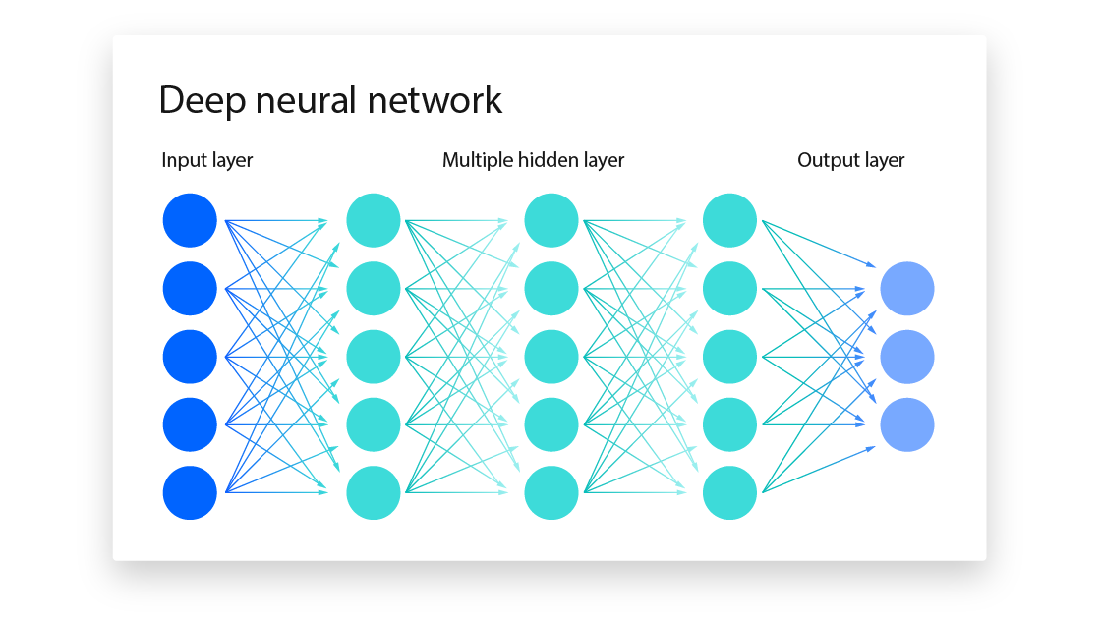
Conclusion
Building Explainable AI Systems
Core Achievement
Implementation
This project demonstrates that structured reasoning can be effectively taught to language models using open tools like Tunix and GRPO.
Kaggle Notebook
Public runnable implementation
GitHub Repository
Key Contributions
Open-source code & docs
1
Lower Barrier to Entry
Impact Areas
Makes building explainable AI systems more accessible.
Academic Research
Industry Applications
2
Open-Source Recipes
Model Interpretability
Provides reusable training recipes for the community.
AI Safety Research
3
Enhanced Trust
✓
Makes models more transparent, interpretable, and reliable.
Training Successful
Model now shows its work
Built with Tunix & GRPO for the Google Tunix Hackathon
Contributing to open-source explainable AI

